Slide 1
PROCESS MATTERS
Commencing Election Units with American Ideals

Slide 2
The Problem
How to teach about the election during a highly partisan era.
How to ensure civil discourse within the classroom, and a positive school and classroom climate.
How to protect the classroom from outside partisan pressures.
How to emphasize that which unites us as Americans.

Slide 3
Rationale for Commencing with American Ideals
American ideals are a source of unity for a diverse nation.
Focusing on American ideals places valid parameters on classroom discussions, rather than opening classroom to statements disruptive of the school climate.
Basing instruction on American ideals in founding documents (especially the Constitution) provides a non-partisan basis for responding to any outside advocacy or pressure groups.
American ideals can form the basis for inquiry-based lessons and provide a reference point for questions and discussions during the year. It can facilitate the infusion of civic education across the curriculum.

Slide 4
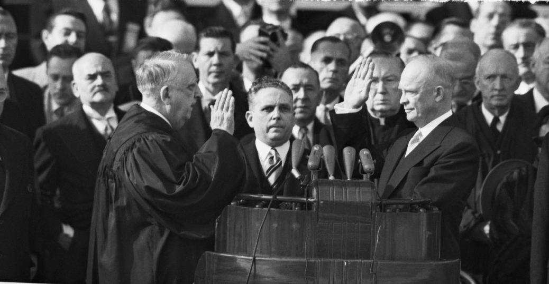
Possible Inquiry Questions
What ideals best define and unite us as Americans?
The president swears a solemn oath to uphold the Constitution. What ideals does he/she implicitly agree to defend and uphold? Which candidate best articulates these ideals?
The oath: I do solemnly swear (or affirm) that I will faithfully execute the office of President of the United States, and will to the best of my ability, preserve, protect, and defend the Constitution of the United States.
What other ideals from our founding documents should the president uphold?

Slide 5
The Process
First Inquiry
Guiding the class to the inquiry and supporting questions regarding ideals.
Brainstorming ideals.
Interpreting documents (in this case, the Constitution) and locating ideals.
Presenting, critiquing, and defending conclusions on ideals, developing a class consensus.
Second Inquiry
Guiding class to inquiry question regarding which candidate best articulates and supports American ideals from the Constitution they will swear to uphold.
Interpreting documents and candidate statements, comparing candidates to ideals
Stating and defending conclusions

Slide 6
Possible Ideals
Democracy
Liberty (negative conception)
Limited Government
Equality
Of opportunity, both political and economic
Equal protection under the laws
Property Rights

Slide 7
Notes
It may be necessary to define what is meant, and expected, by the term “ideals”. Students may confuse these with practices and policies
Once ideals are listed, and before narrowed down to the best or most important five or six, expect to dedicate class time to the precise definition of the terms (ex. What is really meant by “liberty”?)
Identifying ideals should precede any discussions of government, the electoral process, or the candidates.

